Slide 1
TSFM AND tufm GENE Mutation
Hapet Shaybekyan
UCLA Pediatric Research Laboratory
September 13, 2020

Slide 2

Agenda
TSFM and TUFM gene mutation
Biochemistry
  ATP synthesis/Oxidative phosphorylation
  Glycolysis
  Lactic Acidosis
  Krebs Cycle
Conclusion
Suggestions and Questions
References

Slide 3
TSFM and TUFM Gene Mutation
TSFM codes for EF-Ts
TUFM codes for EF-Tu
EF-Tu and EF-Ts

Slide 4
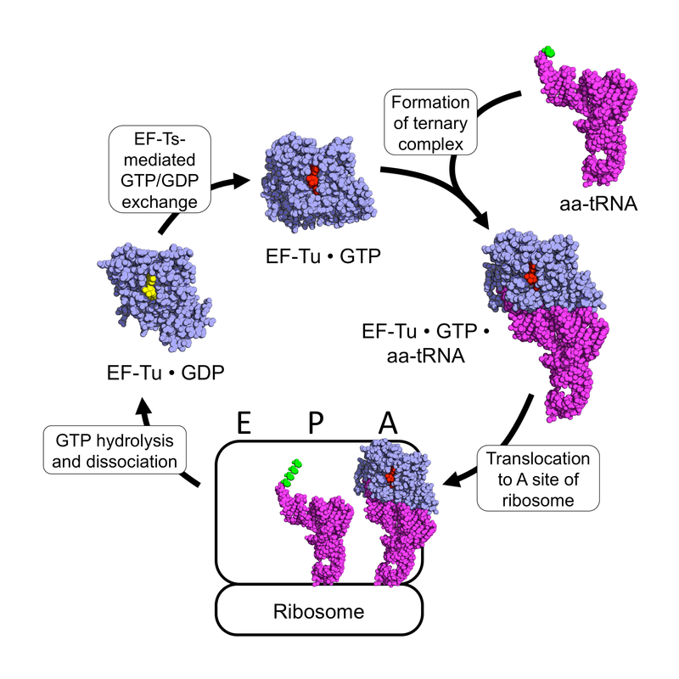

Slide 5
Dysfunction of
EF-TS or
EF-Tu can cause:
Liver failure
Encephalopathy
Lactic acidosis
Hypertrophic cardiomyopathy

Slide 6
Biochemistry
Oxidative Phosphorylation deficiency

Slide 7
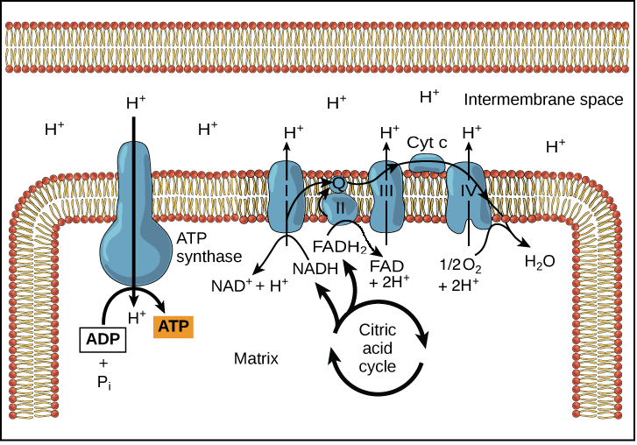

Slide 8
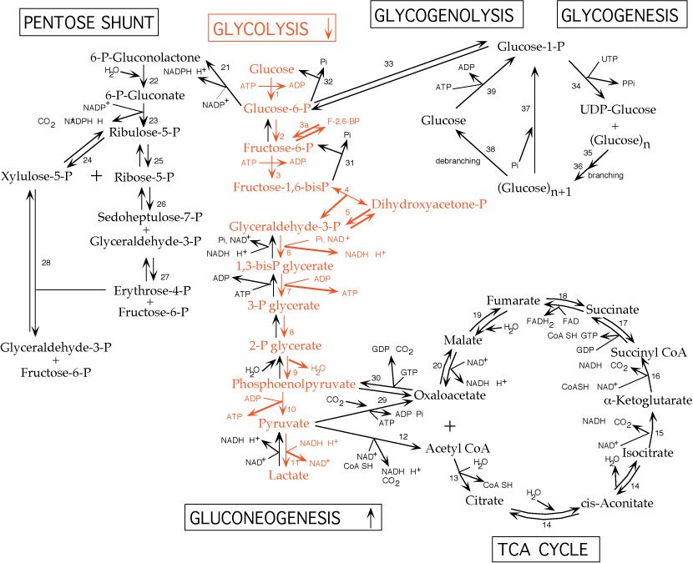
Biochemistry
Glycolysis

Slide 9
Lactic acidosis

Slide 10
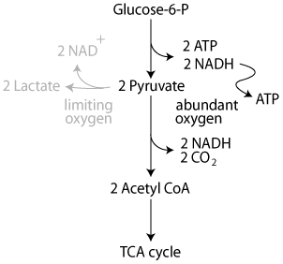

Slide 11
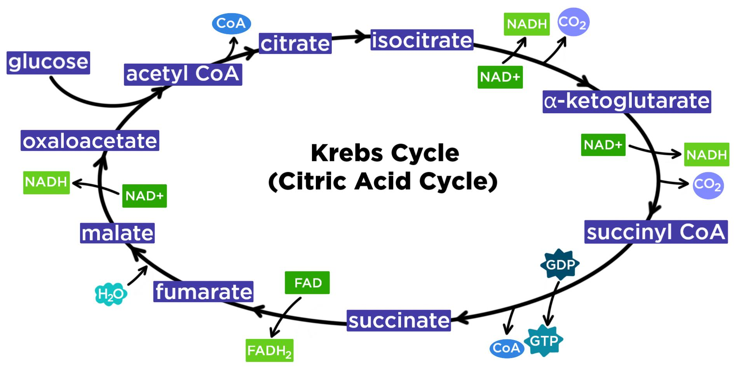

Slide 12
Conclusion

Slide 13
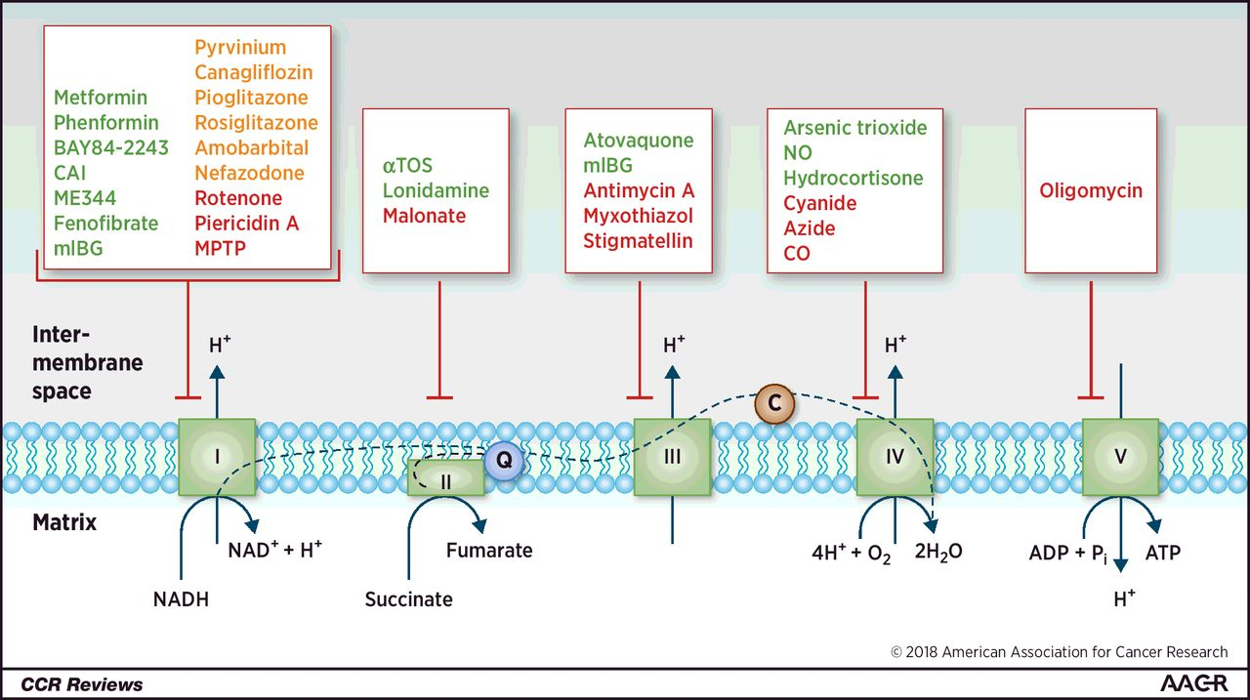

Slide 14
Suggestions and questions

Slide 15
References
Ahajournals.org https://www.ahajournals.org/doi/pdf/10.1161/01.RES.74.6.1141
Combined Oxidative Phosphorylation Deficiency disease: Malacards - Research Articles, Drugs, Genes, Clinical Trials https://www.malacards.org/card/combined_oxidative_phosphorylation_deficiency#sources
G. N. Vemuri, M. A. Eiteman, J. E. McEwen, L. Olsson, J. Nielsen. Increasing NADH oxidation reduces overflow metabolism in Saccharomyces cerevisiae. Proceedings of the National Academy of Sciences Feb 2007, 104 (7) 2402-2407; DOI: 10.1073/pnas.0607469104
More P, Pai K. In vitro NADH-oxidase, NADPH-oxidase and myeloperoxidase activity of macrophages after Tinospora cordifolia (guduchi) treatment. Immunopharmacol Immunotoxicol. 2012;34(3):368-372. doi:10.3109/08923973.2011.606324
Perli, E., Pisano, A., Glasgow, R.I.C. et al. Novel compound mutations in the mitochondrial translation elongation factor (TSFM) gene cause severe cardiomyopathy with myocardial fibro-adipose replacement. Sci Rep 9, 5108 (2019). https://doi.org/10.1038/s41598-019-41483-9
Seo, G.H., Oh, A., Kim, E.N. et al. Identification of extremely rare mitochondrial disorders by whole exome sequencing. J Hum Genet 64, 1117–1125 (2019). https://doi.org/10.1038/s10038-019-0660-y
Theunissen TEJ, Nguyen M, Kamps R, Hendrickx AT, Sallevelt SCEH, Gottschalk RWH, Calis CM, Stassen APM, de Koning B, Mulder-Den Hartog ENM, Schoonderwoerd K, Fuchs SA, Hilhorst-Hofstee Y, de Visser M, Vanoevelen J, Szklarczyk R, Gerards M, de Coo IFM, Hellebrekers DMEI and Smeets HJM (2018) Whole Exome Sequencing Is the Preferred Strategy to Identify the Genetic Defect in Patients With a Probable or Possible Mitochondrial Cause. Front. Genet. 9:400. doi: 10.3389/fgene.2018.00400
TSFM gene https://ghr.nlm.nih.gov/gene/TSFM
Weber G, Nakamura H, Natsumeda Y, Szekeres T, Nagai M. Regulation of GTP biosynthesis. Adv Enzyme Regul. 1992;32:57-69. doi:10.1016/0065-2571(92)90008-n
Wolf H, Chinali G, Parmeggiani A. Kirromycin, an inhibitor of protein biosynthesis that acts on elongation factor Tu. Proc Natl Acad Sci U S A. 1974;71(12):4910-4914. doi:10.1073/pnas.71.12.4910

